Slide 1
Covid-19 Analysis
Joshua Turk, Stephanie Chestnut, Darshan Patel, Kyle Keegan, David Schaffer

Slide 2
Background & Methodology
Now that the height of Covid-19 has passed our group was interested in learning about some of the relationships involving Covid deaths. Leveraging data from the CDC’s website on Covid and Pneumonia Death tolls throughout the United States between 01/01/2020 and 09/30/2023, we sought to answer the following questions:
Which states were most affected by Covid?
Were there differences in the death rates of males compared to females?
What ages were most affected by Covid?
What time of year did Covid have its greatest impact?
What Covid more or less deadly than Pneumonia?

Slide 3
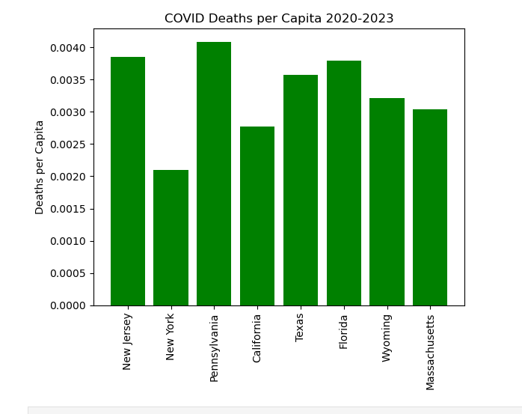
Total COVID death rate since 2020 until September 2023
As expected, New Jersey has a high death rate, being the most densely populated state.
However, Texas and Florida both have a much higher death rate than California, despite being lower populations and being less densely populated. Wyoming, despite being the least populated and one of the least densely populated, has a higher death rate than Massachusetts.
This suggests that, while population density does play a factor in infection and death rate, the state government’s management of the COVID pandemic is also an important factor.

Slide 4
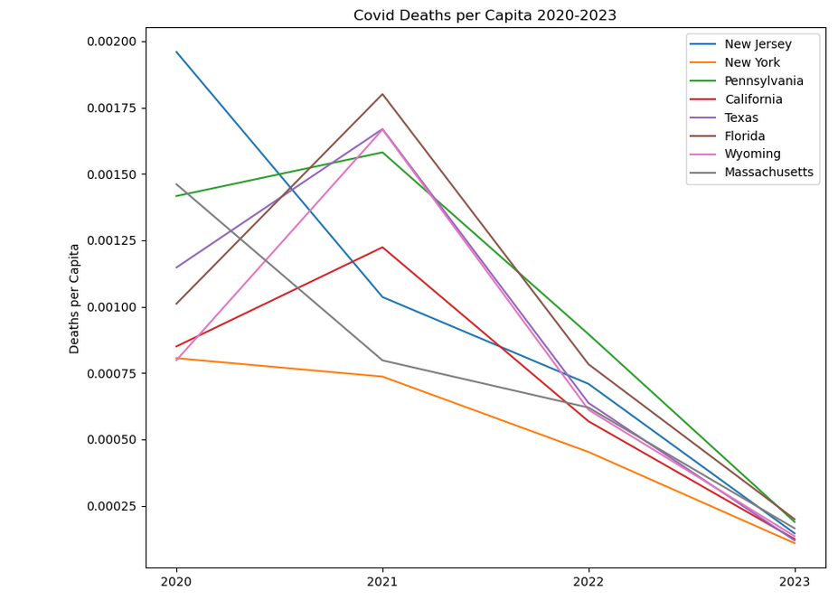
Comparing COVID death rates by year
At the beginning of the pandemic, New Jersey, Pennsylvania, and Massachusetts had high death rates, while Texas, California, and Wyoming were lower.
In 2021, New Jersey’s and Massachusetts’ death rates went down significantly. Pennsylvania’s and California’s both went up a small amount. Florida’s, Texas’, and Wyoming’s skyrocketed in 2021.
In 2022, all states shown here had their death rates go down, which continued to 2023.
The previous graph might lead one to believe NJ had a high death rate throughout the pandemic, however this graph shows that NJ handled the pandemic well enough to cut their death rate by nearly half.

Slide 5
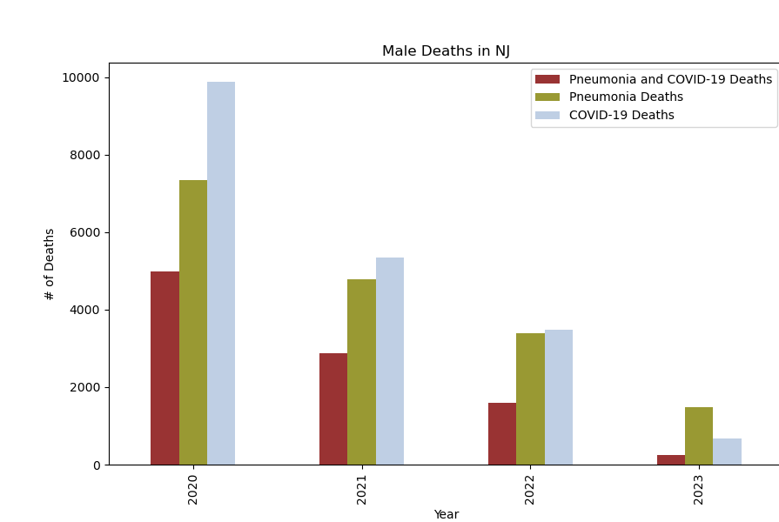
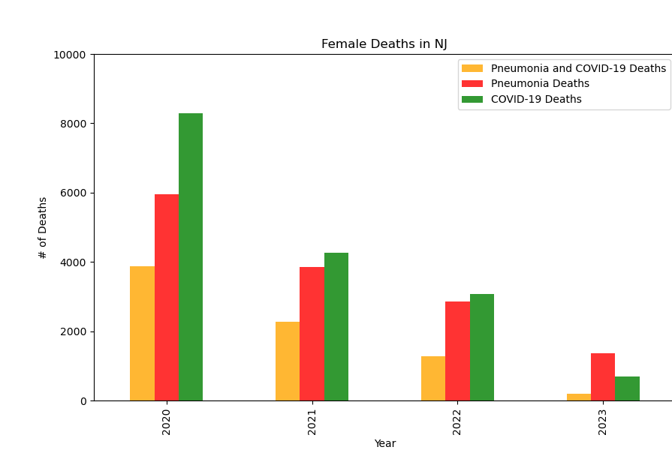
Deaths by Gender in NJ
Across both male and females, as displayed below, the number of covid related deaths was highest in the first year of the pandemic as anticipated.
The decrease in Pneumonia and Covid 19 deaths can be attributed to changes in our health guidelines and vaccinations. While Covid’s reduction can be attributed the newly distributed vaccinations, Pneumonia also decreased due to changes in social regiment like increased cleanliness and wearing masks in public which wasn’t as common before the pandemic.
(Kyle)

Slide 6
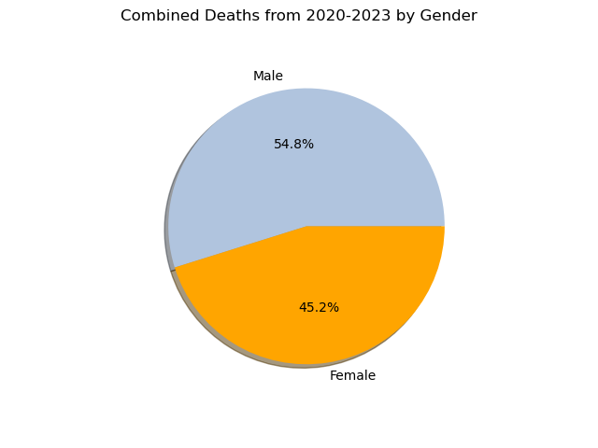
Total Percentage by Gender in NJ
Sex | Deaths
Male | 46,065
Female | 37,944
Total | 84,009
Across the four years that were capture from 2020 through 2023, there were just over 84k deaths for both genders
Total deaths were based on documented deaths due to COVID-19, Pneumonia, and patients that had Pneumonia and COVID-19 simultaneously.
(Kyle)

Slide 7
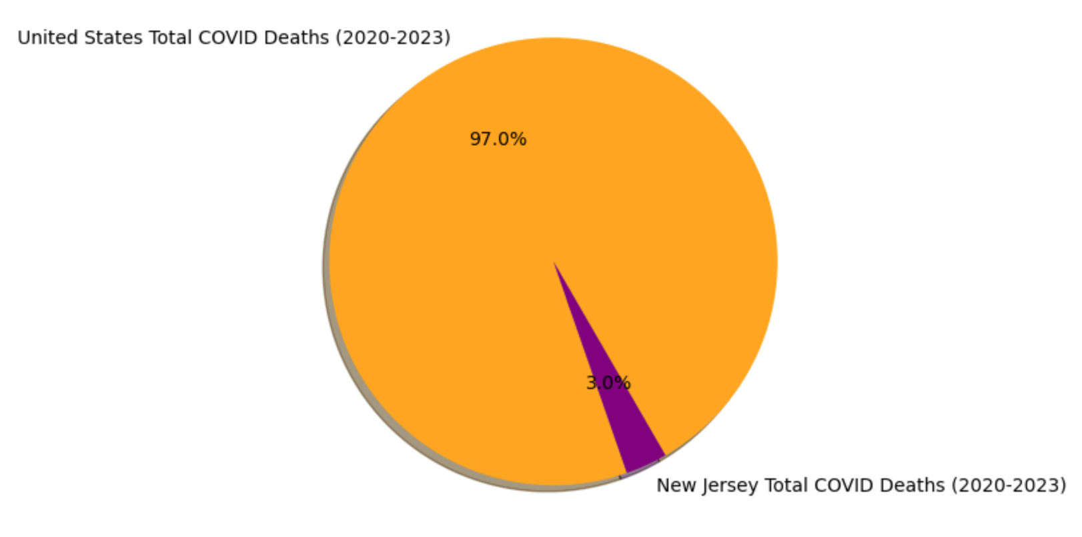
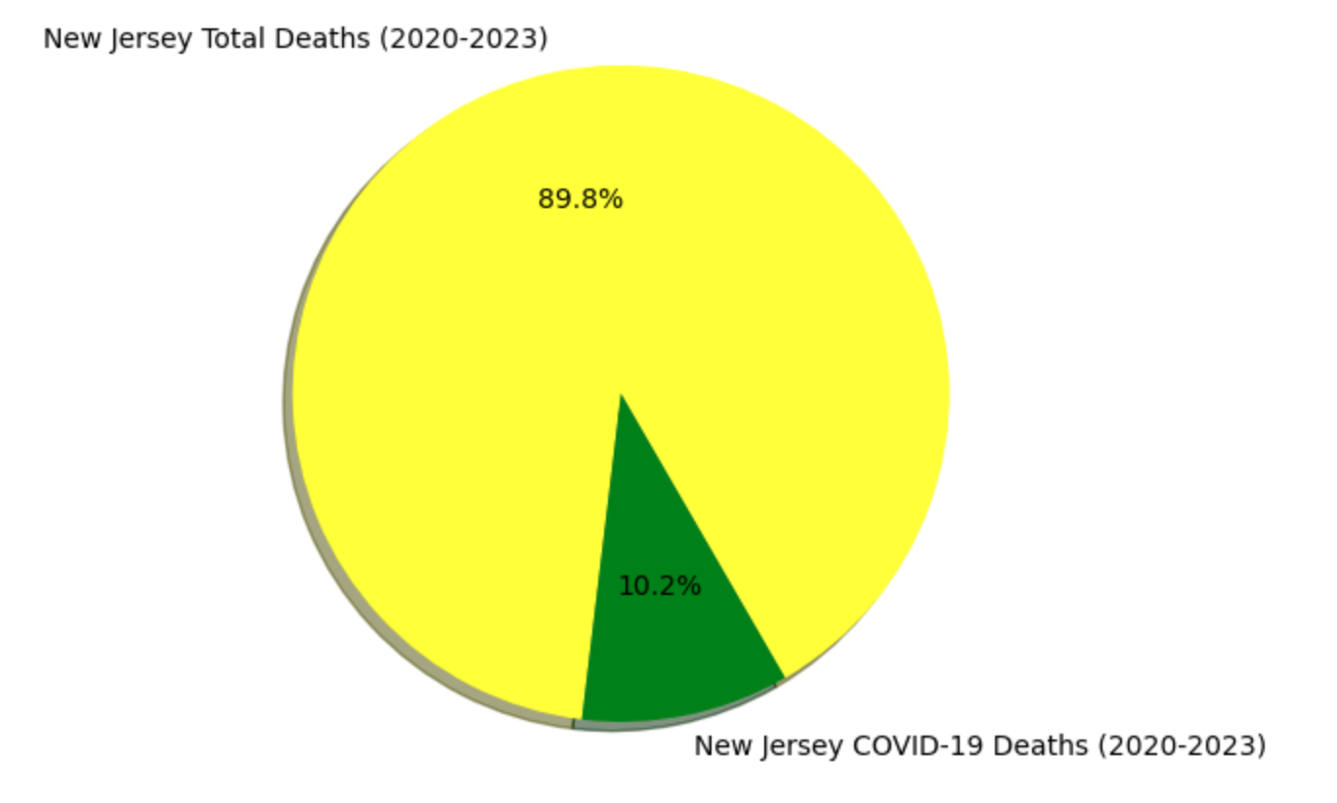
Comparison - US vs. NJ: Overall Deaths vs. COVID-19 Deaths
The total overall death rate and the total COVID-19 death rate in the United States and New Jersey respectively are relatively the same. In comparison there is a 7% difference in the COVID-19 death rate where NJ trended slightly higher than the US.

Slide 8
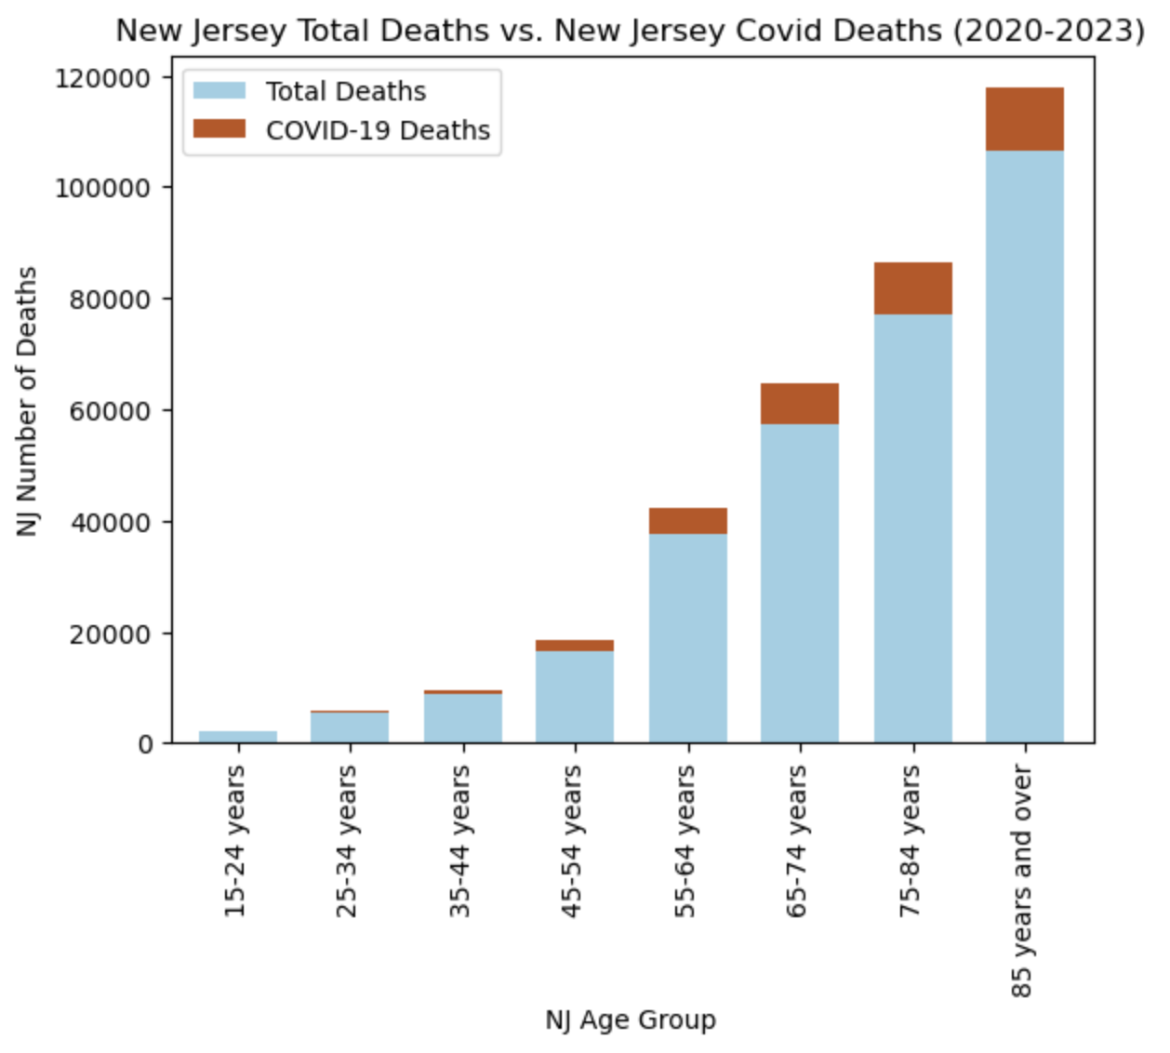
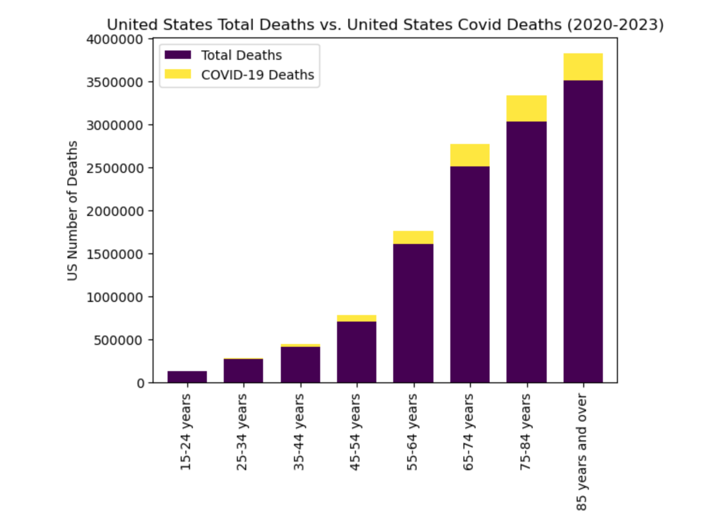
Comparison - US vs. NJ: Overall Deaths vs. COVID-19 Deaths (Age Trends)
The total overall death rate and the total COVID-19 death rate in the United States and New Jersey between 2020-2023 respectively are also relatively the same amongst identified age groups.

Slide 9
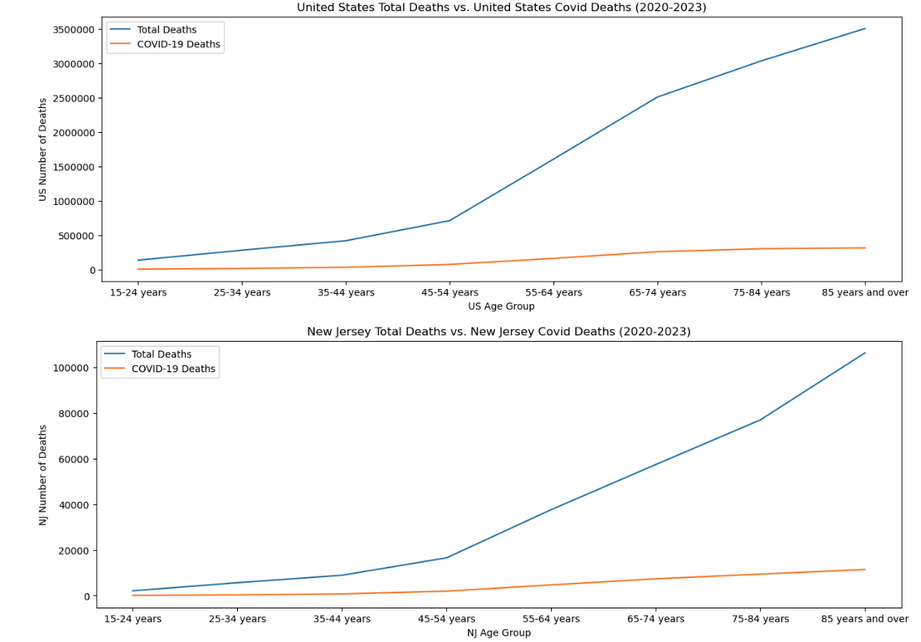
Comparison - US vs. NJ: Overall Deaths vs. COVID-19 Deaths (Age Trends)
The trend for COVID-19 deaths is slightly higher amongst older adults in both the US and NJ. However, NJ shows a larger proportion of deaths in the “85 years and over age group”.
Death rates overall in the US show a prominent increase amongst the 65-75 age group. Death rates comparatively in New Jersey show a prominent increase amongst the 75 and over age groups.

Slide 10
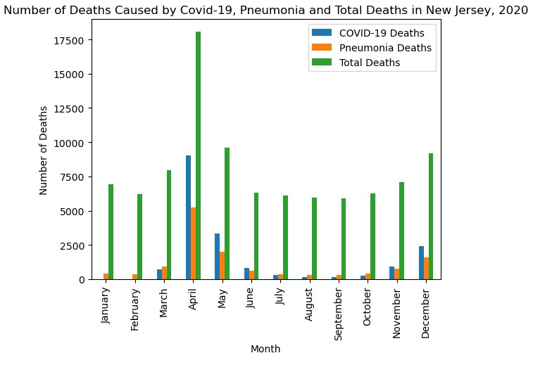
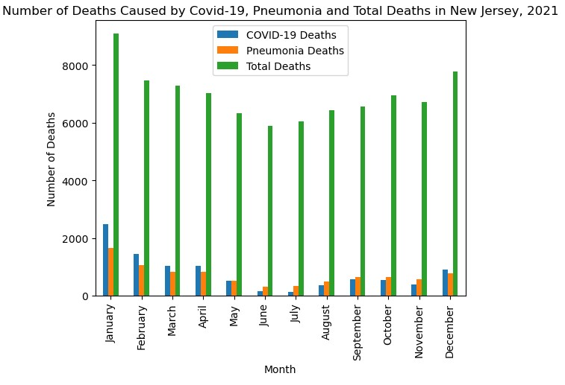
Deaths by Month in New Jersey, 2020- Sept. 2023
The greatest amount of deaths occurred in April 2020. The amount of deaths caused by COVID-19 also tended to be greater than the amount of deaths caused by pneumonia for most of 2020 and 2021.
Spring and summer months tended to have a lower amount of deaths caused by COVID-19, with the months April through September having a lower amount of deaths compared to the fall and winter months

Slide 11
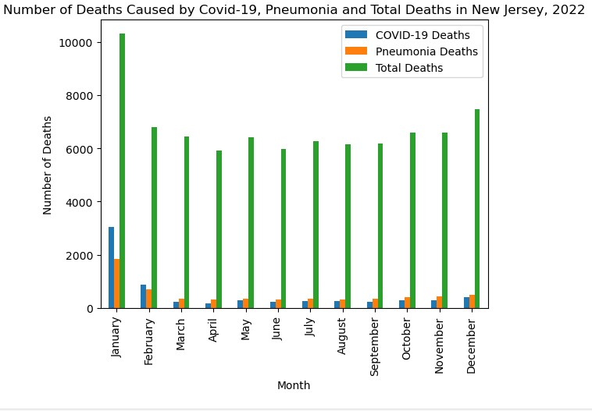
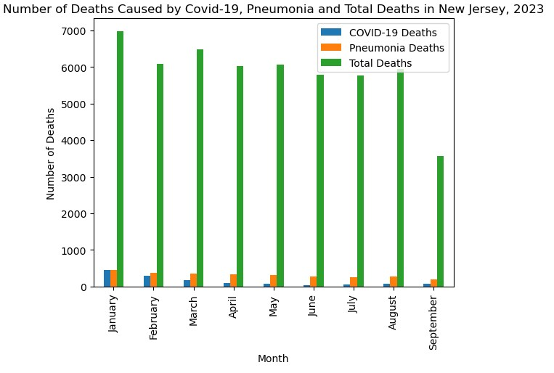
Deaths by Month in New Jersey, 2020- Sept. 2023
Other than 2020, the amount deaths caused by COVID-19 tended to be the greatest in the beginning and end of months, with January and December tending to have the greatest among of deaths caused by COVID-19
From 2020-2023, the amount of deaths caused by COVID-19 significantly dropped with 2023 having significantly less deaths than 2020, due to effective healthcare and safety precautions

Slide 12
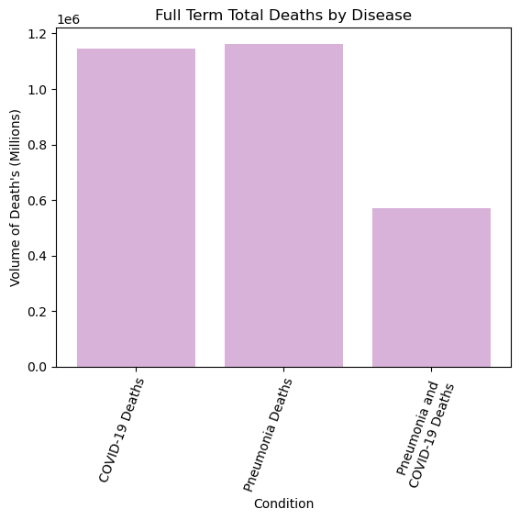
From 2020 to 2023 Pneumonia was equally as fatal as Covid-19 for the US Population
Over the entire data collection period (January 1st 2020 – September 30th 2023), Pneumonia and Covid had close to the same volume of deaths, with Pneumonia leading. There were about half of the recorded deaths for people in the United States that had both Covid and Pneumonia. Considering the volumes for Covid and Pneumonia were so high, it is likely that the population contracted both conditions less frequently than one or the other.

Slide 13
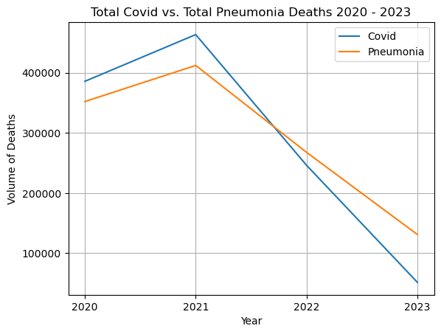
Covid was more deadly in 2020 and 2021 than Pneumonia, before decreasing to less deaths in 2022 and 2023.
At the start of Covid in 2020, the volume of deaths were higher than that of Pneumonia. This trend continued as both conditions saw an increase of deaths into 2021. Afterwards both conditions saw a sharp decline in deaths, with Covid having less overall in 2022 and 2023. This is most likely due to increased vaccinations and covid treatments that began to be released.

Slide 14
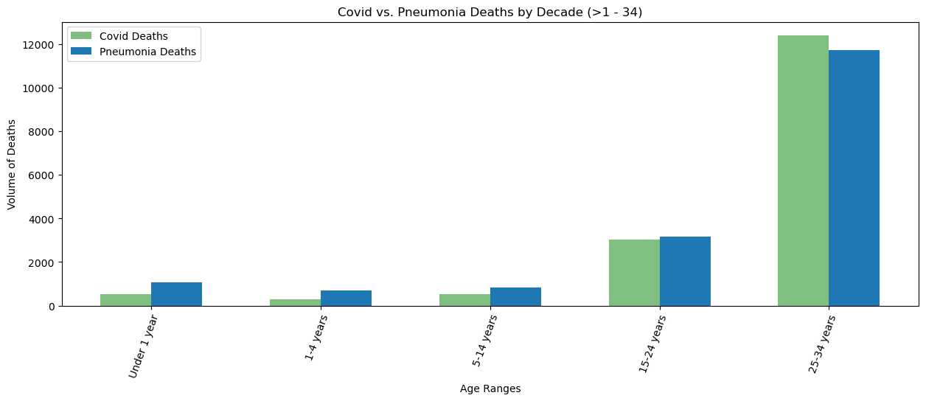
Pneumonia caused more deaths in the younger population while 24-34 year old's saw a significant increase in volume of deaths due to both diseases.
For the younger population, there were more Pneumonia deaths than Covid, especially for those under 14 years old. This suggests than either it was more fatal, or more people contracted Pneumonia than Covid for this age group. Also, for both Covid and Pneumonia there was a large increase in the amount of deaths when comparing the 15-24 age group with the 25-34 year age group. We also see Covid having the higher volume of deaths for this age group.

Slide 15
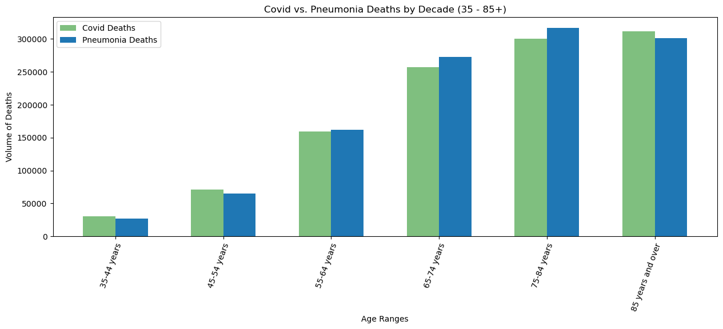
Covid and Pneumonia was most deadly in the elderly populations, while the middle aged crowd seemed to be effected more by Covid than Pneumonia.
As the age continues to increase, we notice that for the middle aged crowd, there are slightly more covid deaths than pneumonia deaths. Then as we move into the elderly crowd, Pneumonia has more death for 65-84 year old’s. Also, we see a big increase in deaths from 45-54 to 55-64, and then again from 55-64 to 65-74 for both diseases. This shows that as the populations age increases, the fatality of contracting the disease likely increases as well.

